Slide 1
Functions

Slide 2
Before we start….
Change your seats and take 5 minutes to get to know your new neighbors. Sit by people you do not know!
Let’s run through our git sequence so you can get my changes, and then create a Lesson3 notes for yourself…
But what if you want to create your own repository…?

Slide 3

Motivation

Slide 4
The Dunning-Kruger effect
The Dunning–Kruger effect is a cognitive bias that describes the systematic tendency of people with low ability in a specific area to give overly positive assessments of this ability.
Keep pushing yourself. Even if you think you’re great.

Slide 5
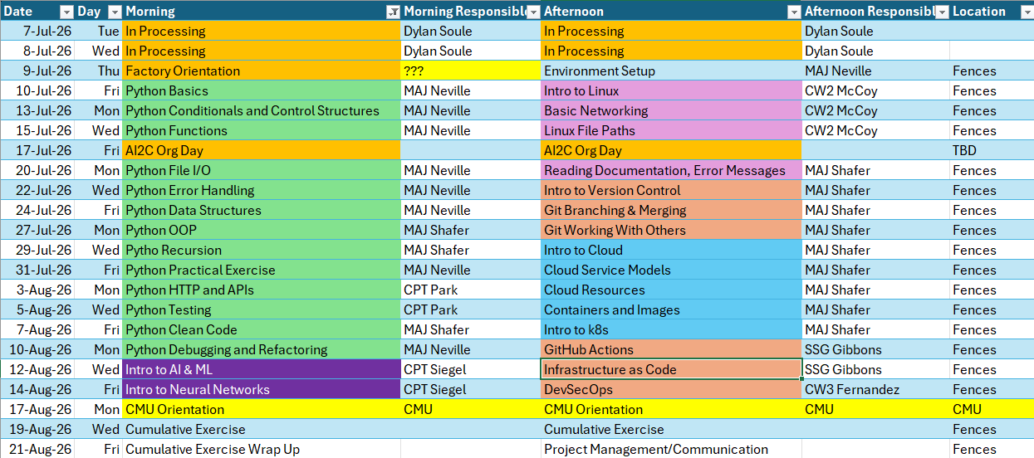
Course Schedule

Slide 6
Review

Slide 7
Problem 1
Print the numbers from 1 to 100. If the number is divisible by 3, print “Fizz” instead of the number. If it is divisible by 5, print “Buzz” instead of the number. If it is divisible by both, print “FizzBuzz” instead of the number.
Problem 2
Ask the user for “rock”, “paper”, or “scissors”. Randomly assign the computer’s choice of “rock”, “paper”, or “scissors”. Display whether the user won, lost, or tied.

Slide 8
Problem 3
Create a guessing game. Randomly assign a number from 1 to 100 (using the random module). Ask the user to guess the number. If the user guesses higher, display “Too high”. If the user guesses lower, display “Too low”. Congratulate the user when they guess the correct number. Continually ask the user until they get the number correct.
Bonus: Display to the user how many times they guessed.
Problem 4:
Write a program to help you track your student’s grades. Ask the user how many students are in the class. For each student, ask their name and their grade. Display the class average. Display the highest grade in the class. Display the lowest grade in the class.
Bonus: Display who got the highest grade in the class.

Slide 9
Modules

Slide 10
What are some built-in Python functions that we have learned about?

Slide 11
What if we want to add in some extra functionality to Python? Give it a little boost?

Slide 12
What are modules?
A Python module is simply a file containing Python code — variables, functions, or classes— that you can import and use in other files.
Notes:
GLOBAL MODULE INDEX

Slide 13
3 types of modules
Built-in Modules – they come with Python, no installation necessary
Your own modules – any .py file you write yourself
Third-party modules – installed via pip
Notes:
GLOBAL MODULE INDEX

Slide 14
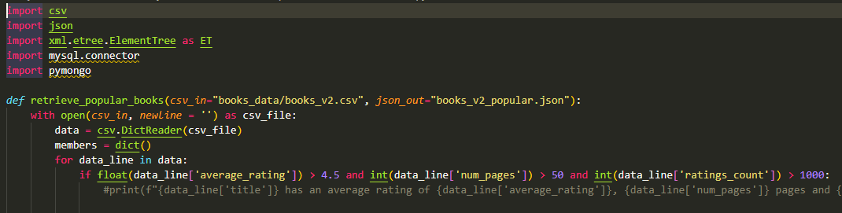
Import modules at the top of your code!!!!
Notes:
GLOBAL MODULE INDEX

Slide 15
Built-in Modules
There are many built-in modules, but we are going to look at two…
random module
math module
Notes:
GLOBAL MODULE INDEX

Slide 16
Random Module
This module implements pseudo-random number generators for various distributions.
Go to https://docs.python.org/3/library/random.html and look at the following functions. What do they do?
random.randint(a,b)
random.choice(seq)
random.random()
Notes:
GLOBAL MODULE INDEX

Slide 17
Write a Python Script that randomly generates an integer from 0 to 100. If the integer is less than 50, state “The number is less than 50” if the number is 50, state “The number is 50” if the number is greater than 50, state “The number is greater than 50” *Display the number to check your code*

Slide 18
Write a Python script that: name_list = [“John”, “Rachel”, “Sam”, “Carlos”, “Jane”] Randomly picks a name from the list. Print the name.

Slide 19
Math Module
This module provides access to common mathematical functions and constants such as sin() and pi.
Go to https://docs.python.org/3/library/math.html and look at the following functions/constants. What do they do?
math.dist(p, q)
math.pi
math.degrees(x)
Notes:
GLOBAL MODULE INDEX

Slide 20
You want to build a circular patio for your home. Write a program that prompts the user for the diameter of their patio (in feet). With the diameter, calculate the total area of the patio. Print the total area of the patio. Print the number of bricks you suggest the user buys for their project. (Bricks are 4” x 6”) Use math.pi

Slide 21
User defined functions

Slide 22
How do we create our own functions?
Define the function
2) Call the function
(parameter1, parameter2…):
(argument1, argument2…)
def
function_name
function_name
FUNCTION BODY
return statement
(number1, number2):
result1 = add_together
(10, 20)
def
add_together
sum = number1 + number2
result2 = add_together(5, 7)
return sum
result3 = add_together(100, 10)
What would be printed out if we ran these three lines of code?
print(result1)
print(result2)
print(result3)
Notes:
Sous Chef Example

Slide 23
In Class Exercise #1
Write a python function that calculates and returns the area of a rectangle using two integer inputs from the user! Outside of the function call, print the area.

Slide 24
In Class Exercise #2
Write a function called tip() that has two parameters named total and percentage.
This function should return the amount you should tip given a total and the percentage you want to tip. Print the amount returned outside of the function call.
tip(10, 25) = 2.5

Slide 25
In Class Exercise #3
Write a function that takes a numerical input from the user, cubes that number, and then returns the result. Print the result outside of the function call.

Slide 26
In Class Exercise #4
Write a function that is called “has_more_characters”. This function should accept two strings as arguments, and will return the string that has more characters. Outside of the function call, print the string with more characters.
Notes:
15 min left

Slide 27
In Class Exercise #5
Write a function that is called “count_char_x”. This function should accept two inputs, a word and a character. The function will return how many instances of the character are in the word.

Slide 28
What did you learn?

Slide 29
Admin

